Slide 1
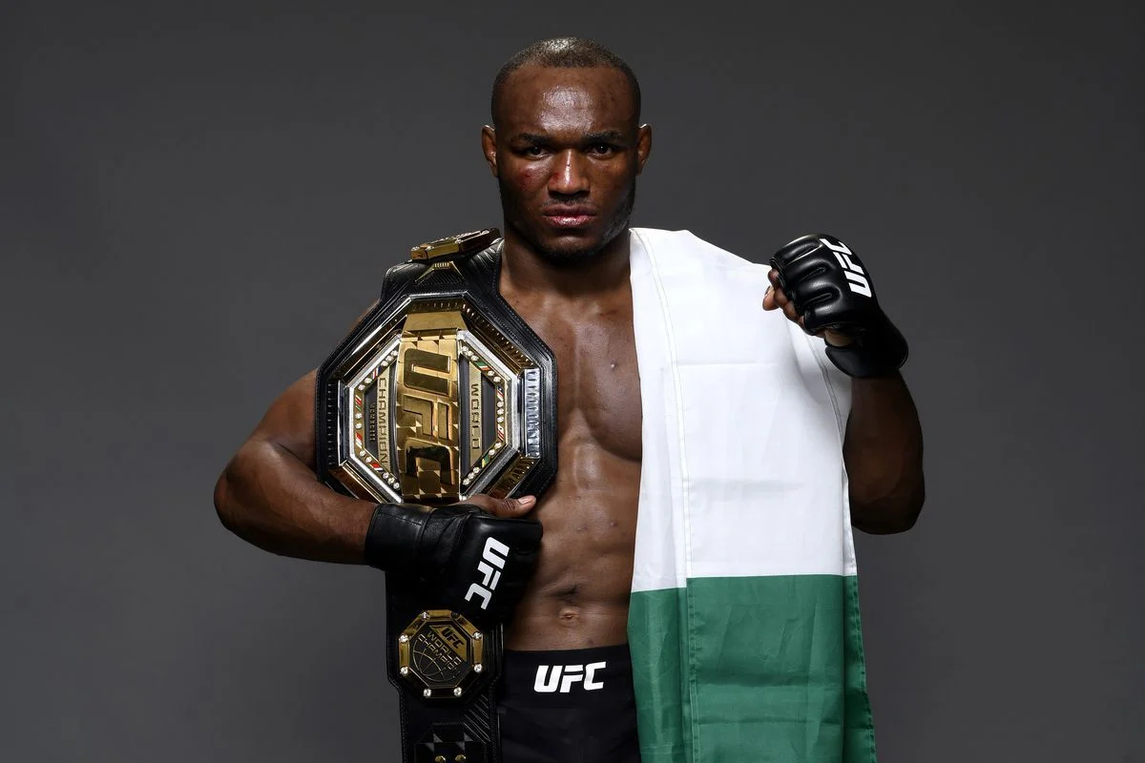
UFC Fight Outcome Prediction
Emmanuel Nnadi
August 11th 2023

Slide 2

Brief introduction
Introduction: The Ultimate Fighting Championship (UFC) is a premier Mixed Martial Arts (MMA) organization that showcases top-ranked fighters in combat sports. As the popularity of the UFC has surged, so has the importance of using data analytics and machine learning to gain a competitive edge.
Objective: Our aim is to harness the power of data science to:
Understand the key factors that contribute to a fighter's success in the octagon.
Develop machine learning models to predict fight outcomes based on historical data and fighter metrics.
Provide key insights to stakeholders.
By achieving this objective, we not only delve deep into the intricate dynamics of MMA but also demonstrate the applicability of data-driven decision-making in sports analytics.
What is the ufc?

Slide 3
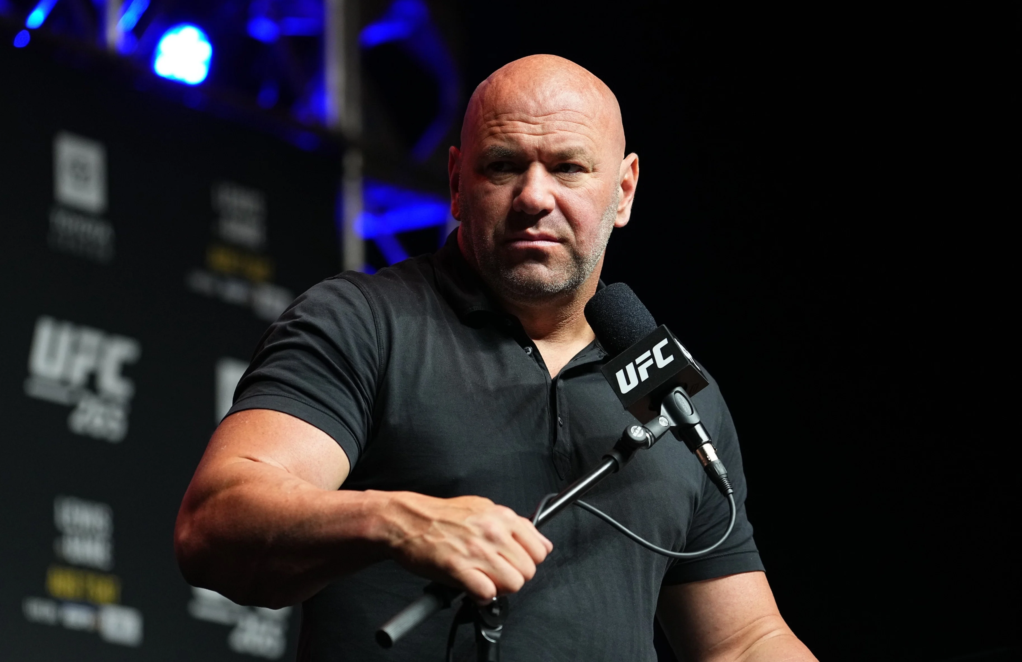
wHY THE UFC?
Why the UFC? - A Multifaceted Perspective
The Ultimate Fighting Championship (UFC) is more than just a combat sport; it's a global brand with multifaceted implications. Here's why I chose the UFC:
Strategic Betting
Content Creation
Growing Influence
Event Planning
Growth Opportunities
Dana White
President of the UFC
Notes:
The Ultimate Fighting Championship (UFC) is more than just a combat sport; it's a global brand with multifaceted implications. Here's why I chose the UFC:
Strategic Betting: With the legalization of sports betting in many regions, there's a surging demand for predictive analytics. Accurate fight predictions can benefit both casual bettors and professional sportsbooks.
Content Creation: Deep insights from fight data can fuel engaging content for fans. From pre-fight analysis videos to post-fight breakdowns, data-driven content can elevate the fan experience.
Growing Influence: With the rise of sports analytics, the UFC community is actively seeking data-driven insights to optimize training and strategize fights.
Event Planning: Predictive analytics can assist promoters in matchmaking, ensuring closely contested and exciting fights that maximize ticket sales and Pay-Per-View buys.
Growth Opportunities: Analyzing fight data can help the UFC identify emerging stars, potential matchups, and markets that haven't been tapped into, guiding expansion strategies.

Slide 4
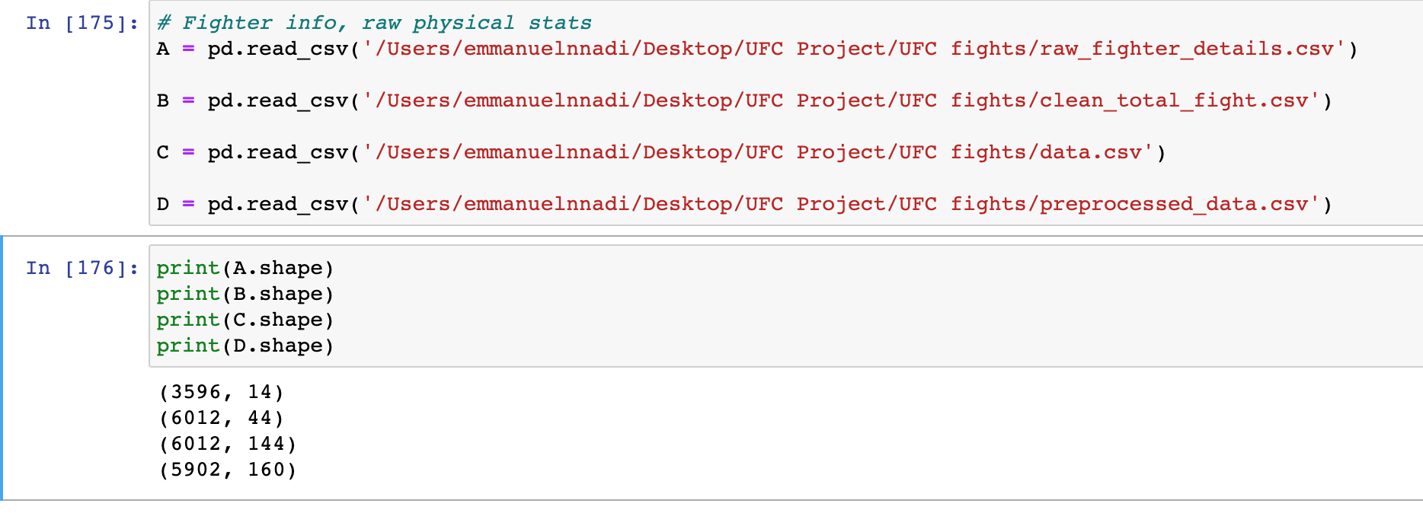
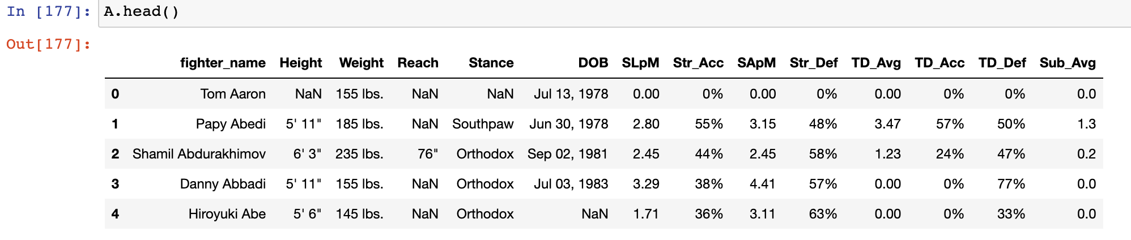
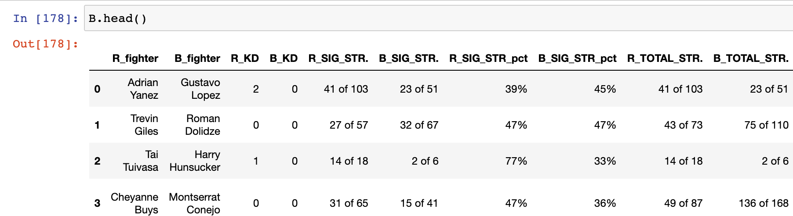
Data sets used
Size and shape
Observations: A lot of the dataset had repeated fighter details, so some needed to be left joined and others left out to create a final dataframe for analysis.
Some datasets had similar info just a few missing columns to be merged.

Slide 5
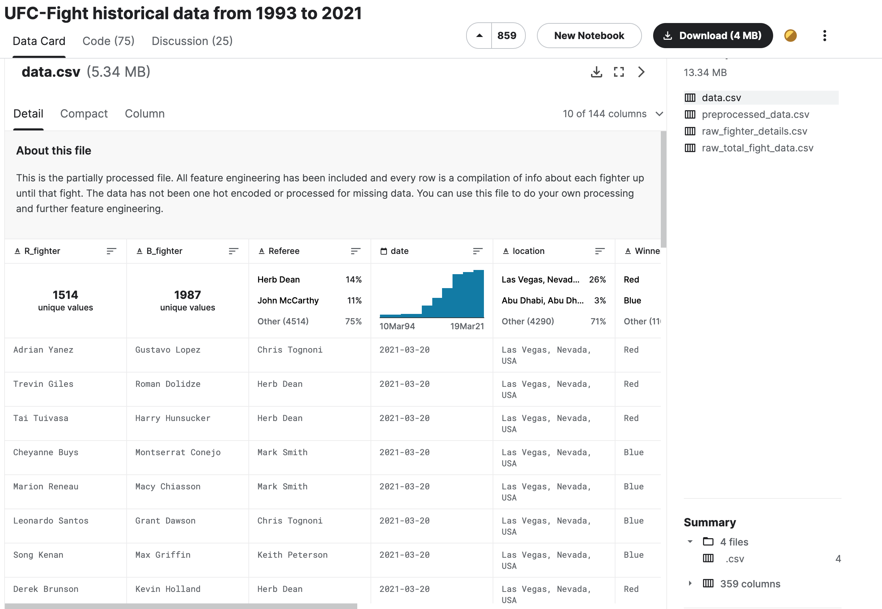

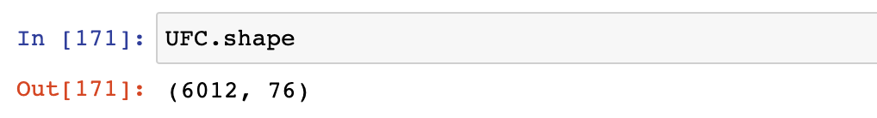
Dataset OVERVIEW
The data set was from the Kaggle website.
IT Consists of 4 CSVs.
Raw_fighter_details = Fighter physical stats
Total_Fight_Data = Fighter Info Scraped
Data = Head to head fights with outcomes
Prep_data = Averages for the winners
The necessary data sets were merged and other columns were dropped to give a final UFC dataframe.

Slide 6
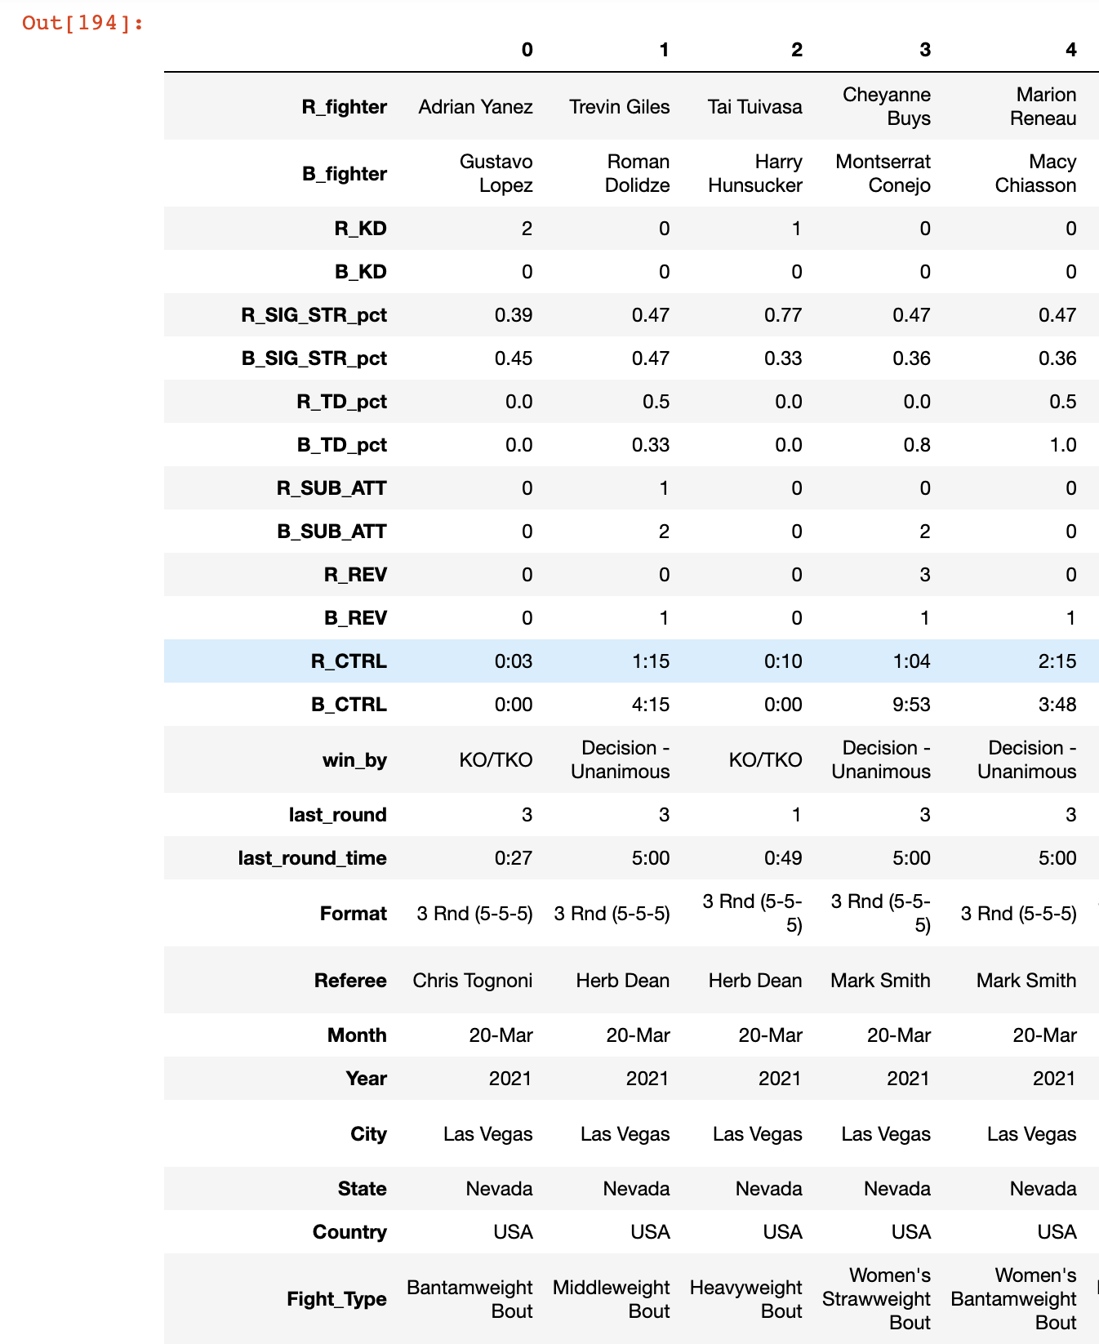
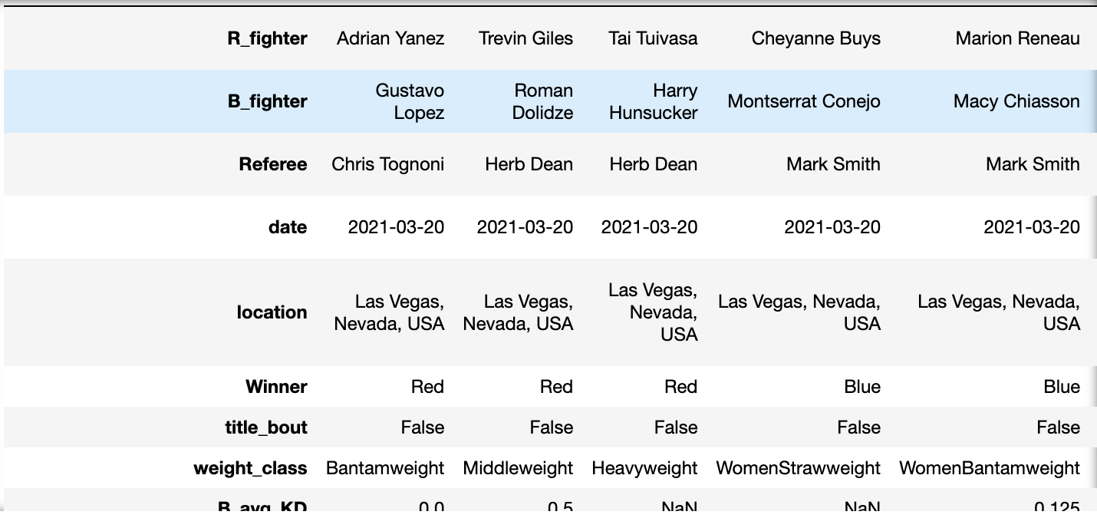
Snapshot of the transposed merged data
It has many important fight stats in the columns. Transposed the data for presentation purposes.
Note this is just a sub section of the data.

Slide 7
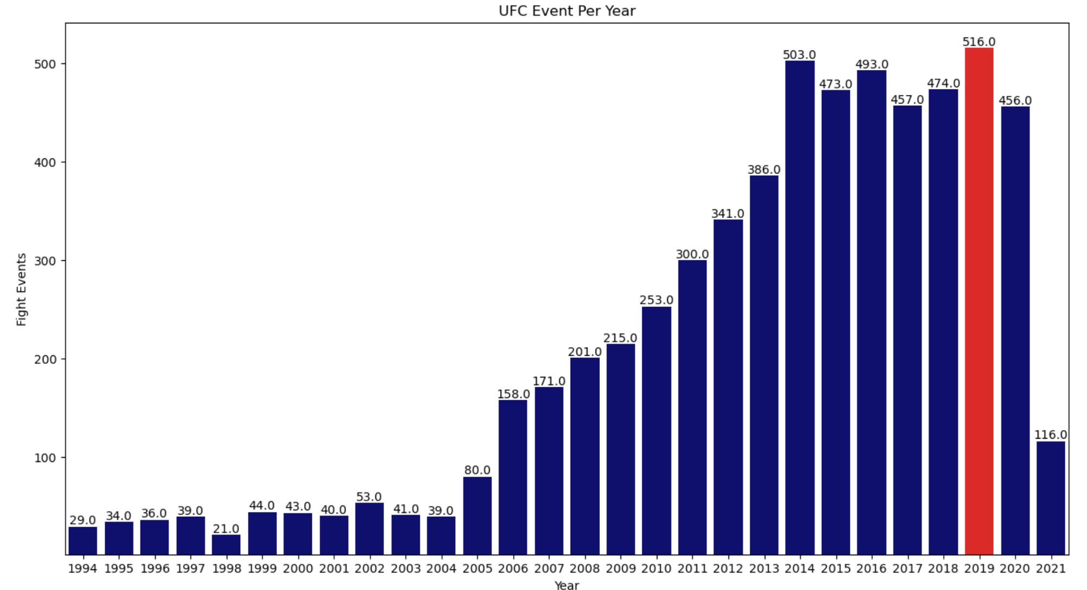
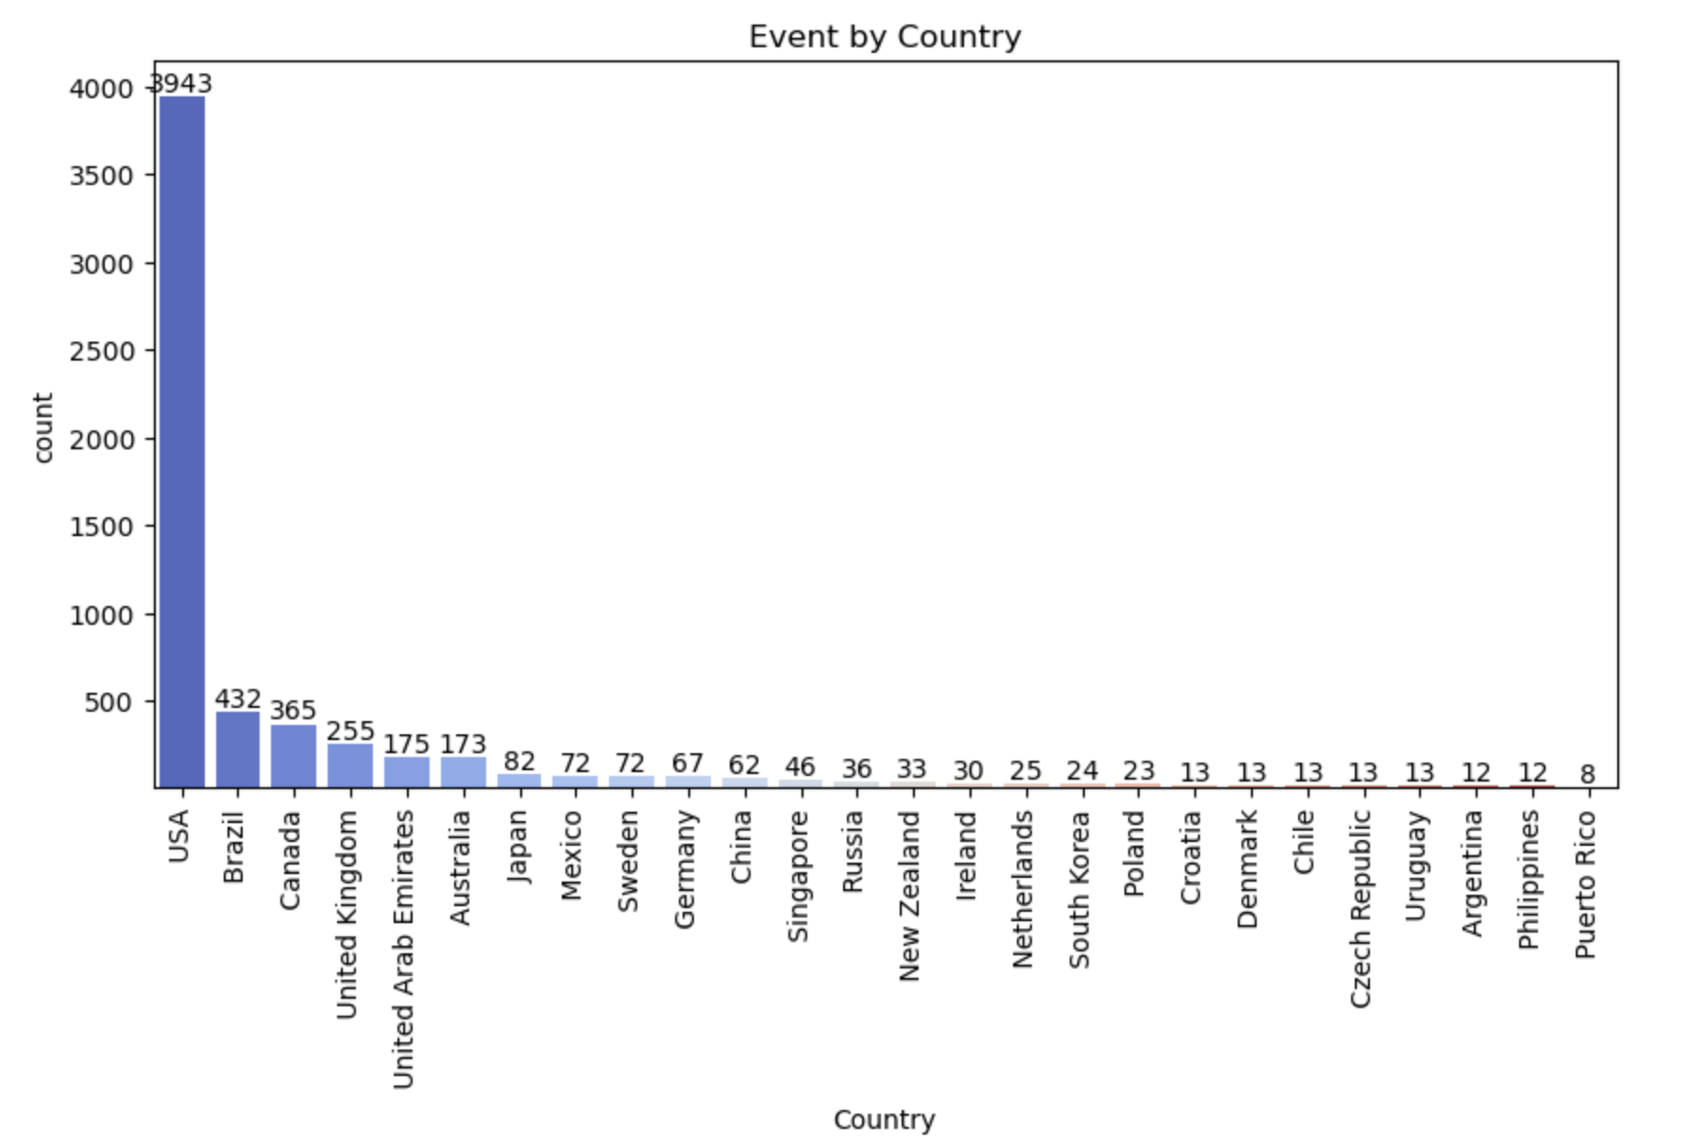
Events kEY INSIGHTS

Slide 8
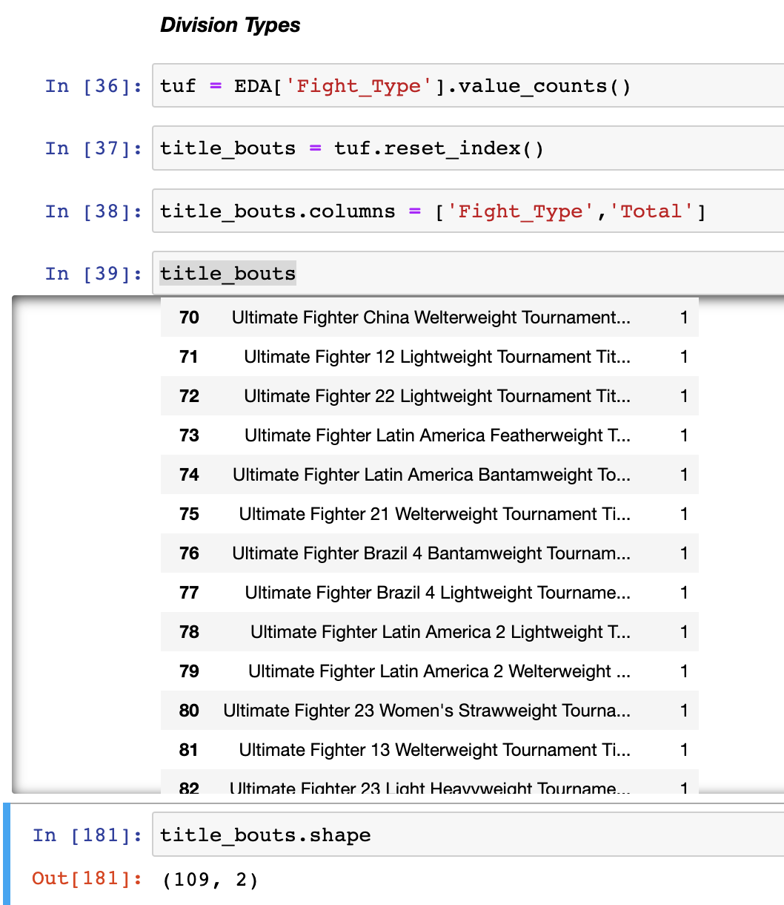
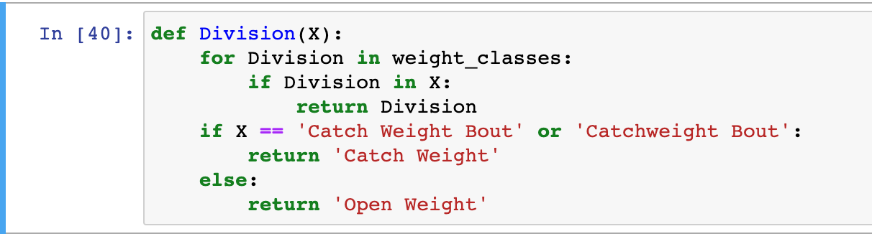
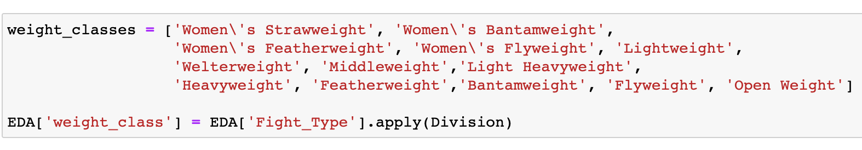
FEATURE ENGINEERING FOR A DEEPER DIVE

Slide 9
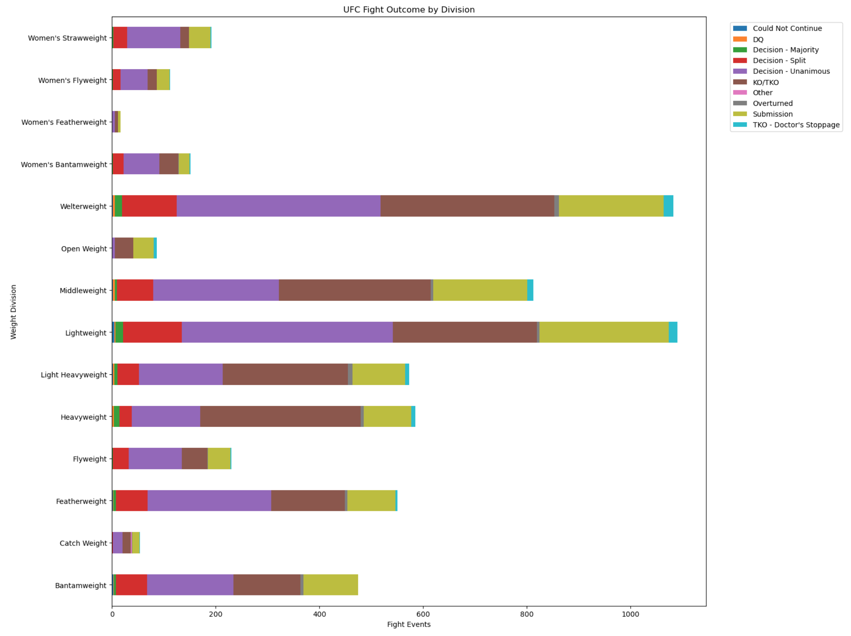
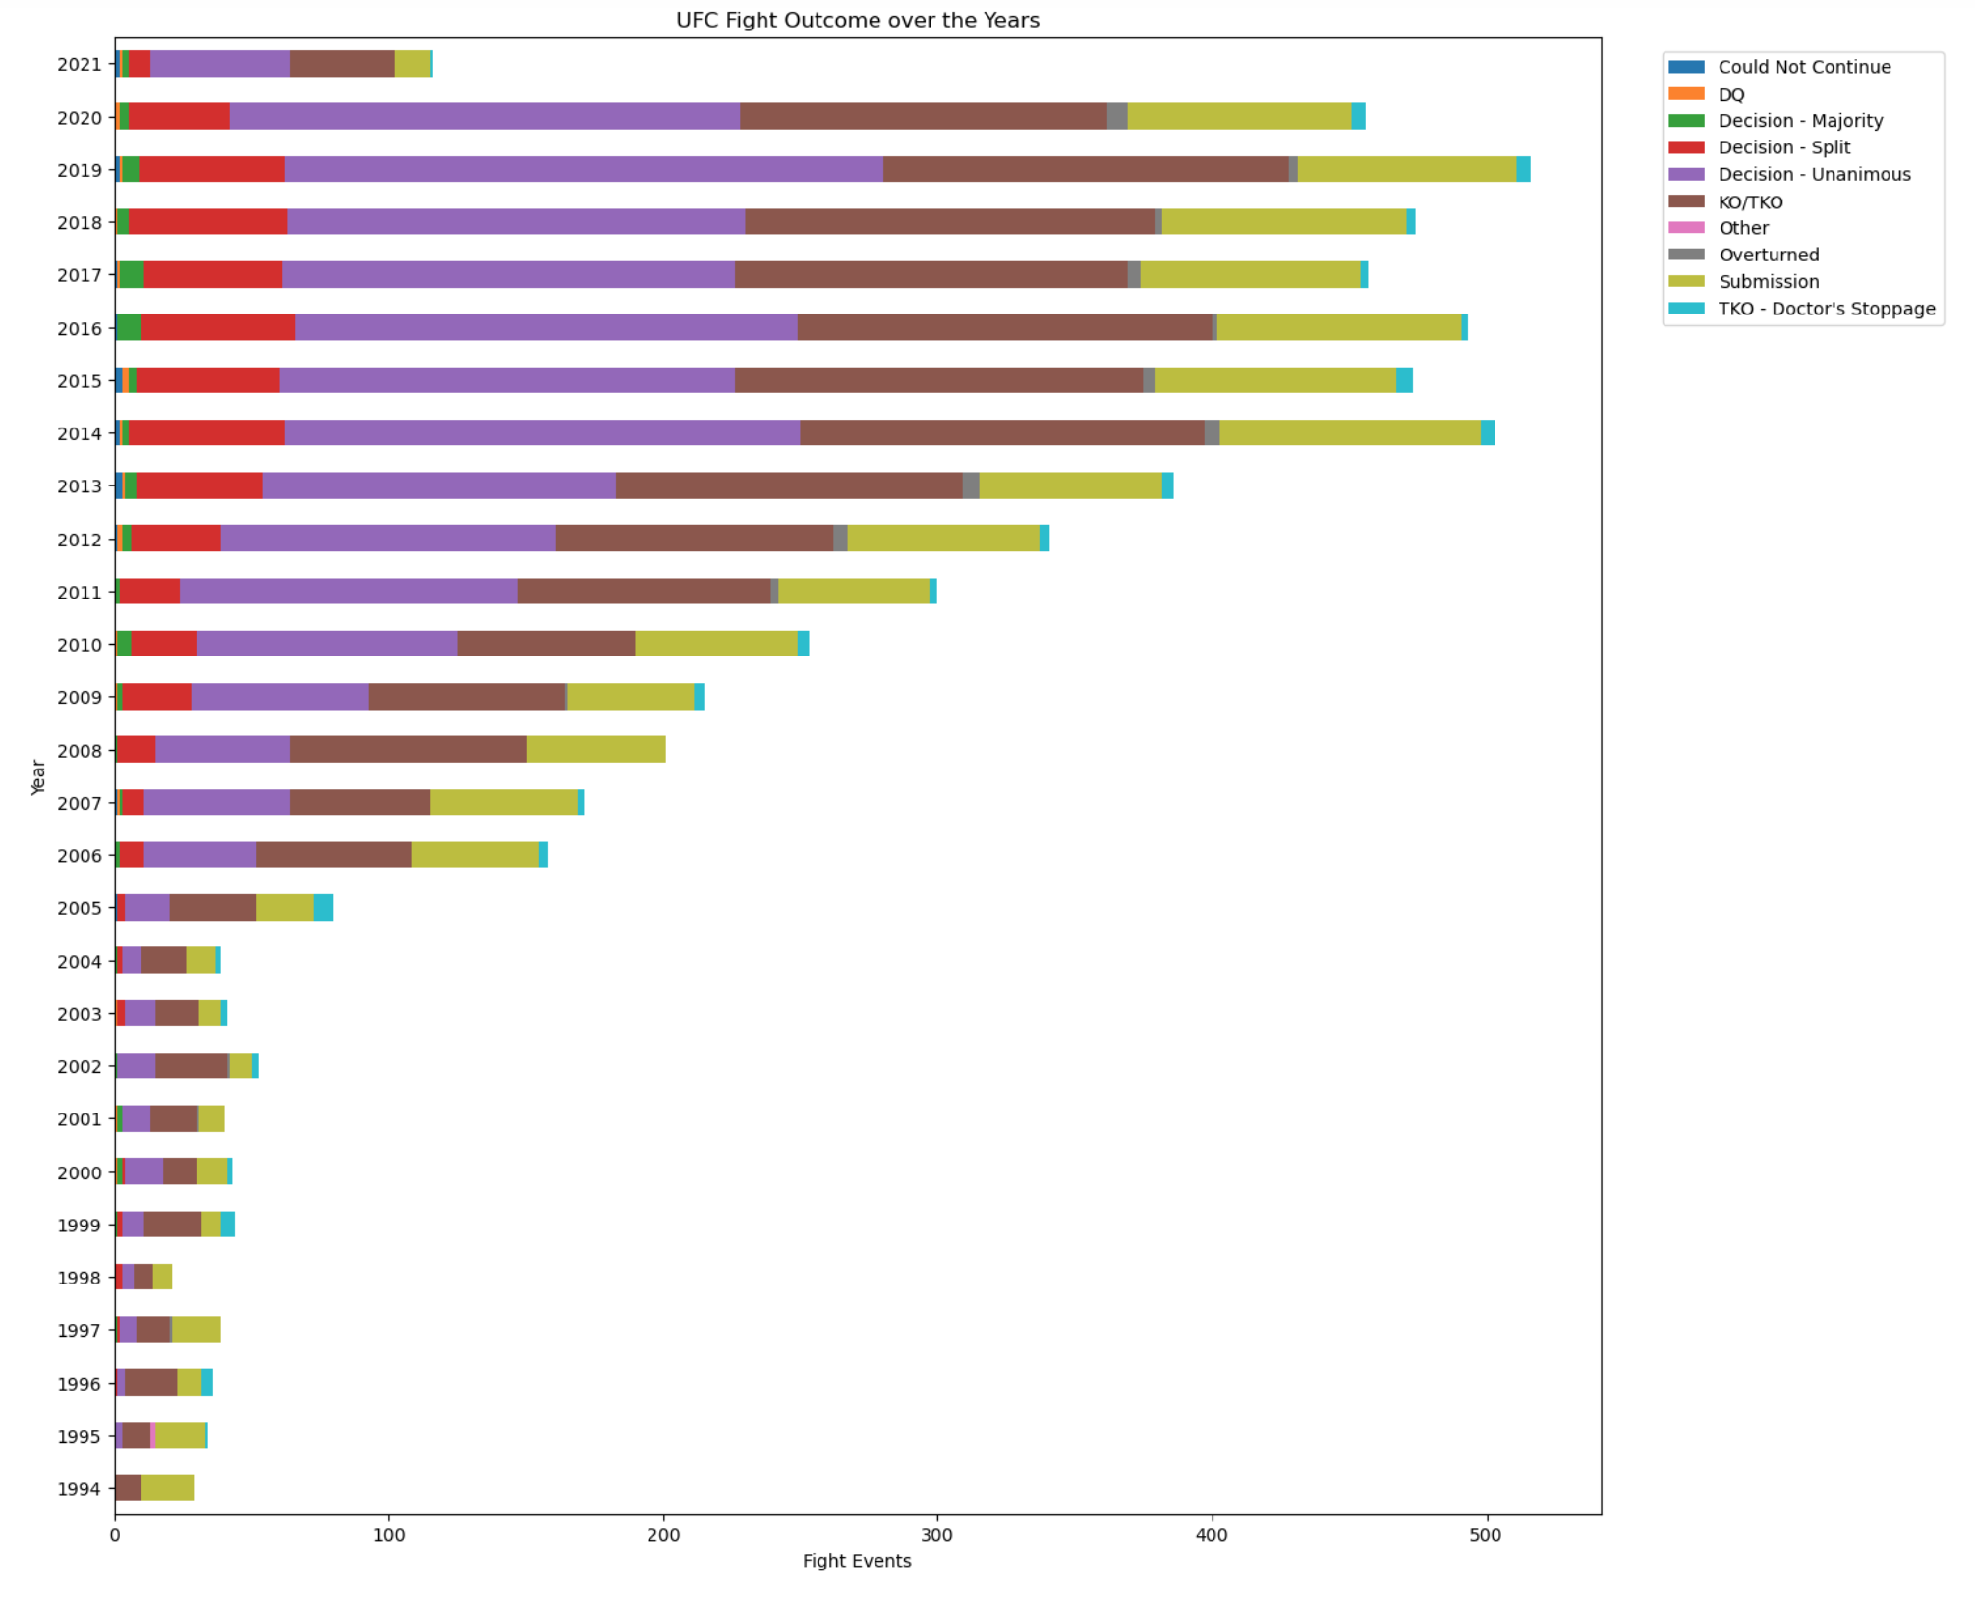
EVENTS KEY INSIGHTS

Slide 10
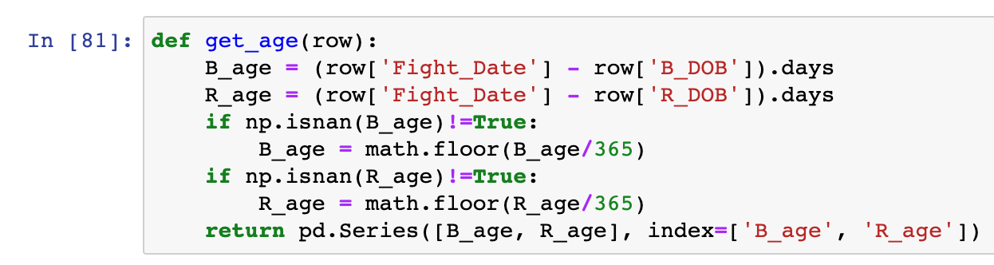
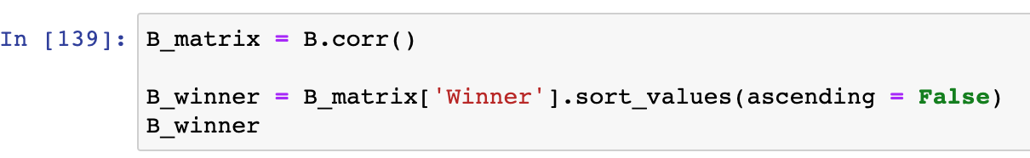
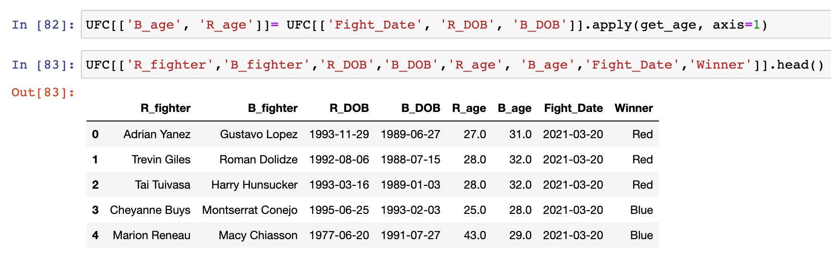
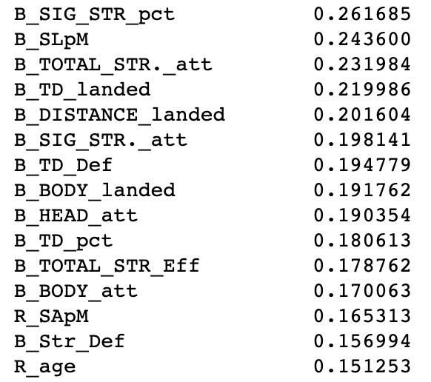
Feature engineering age
Notes:
Age of Fighters Creation
Age can play a role in UFC fights. Fighters' age can impact their performance in several ways:
Physical Peak: Fighters typically reach their physical peak in terms of strength, speed, and endurance in their late 20s to early 30s. This age range is often considered optimal for achieving top athletic performance.
Recovery: Younger fighters might have an advantage in terms of recovery time between fights. As fighters age, their bodies may take longer to recover from injuries and intense training sessions.
Experience: Older fighters may have the advantage of more experience in the sport. Experience can lead to better fight strategy, better understanding of opponents' tendencies, and improved mental preparation.
Injury Susceptibility: Older fighters might be more prone to injuries due to wear and tear on their bodies from years of training and fighting. This can impact their training regimen and overall performance.
Adaptation: Younger fighters might be more adaptable to new techniques and training methods. Older fighters might find it harder to learn new skills or adapt to changes in the sport.
Mental Toughness: Experience that comes with age can contribute to better mental toughness and composure during fights. Older fighters might handle the pressure of the big stage better.
It's important to note that while age can be a factor, it's just one of many variables that contribute to a fighter's success in the UFC. Physical condition, skill level, training regimen, mental state, and other factors also play critical roles in a fighter's performance.

Slide 11
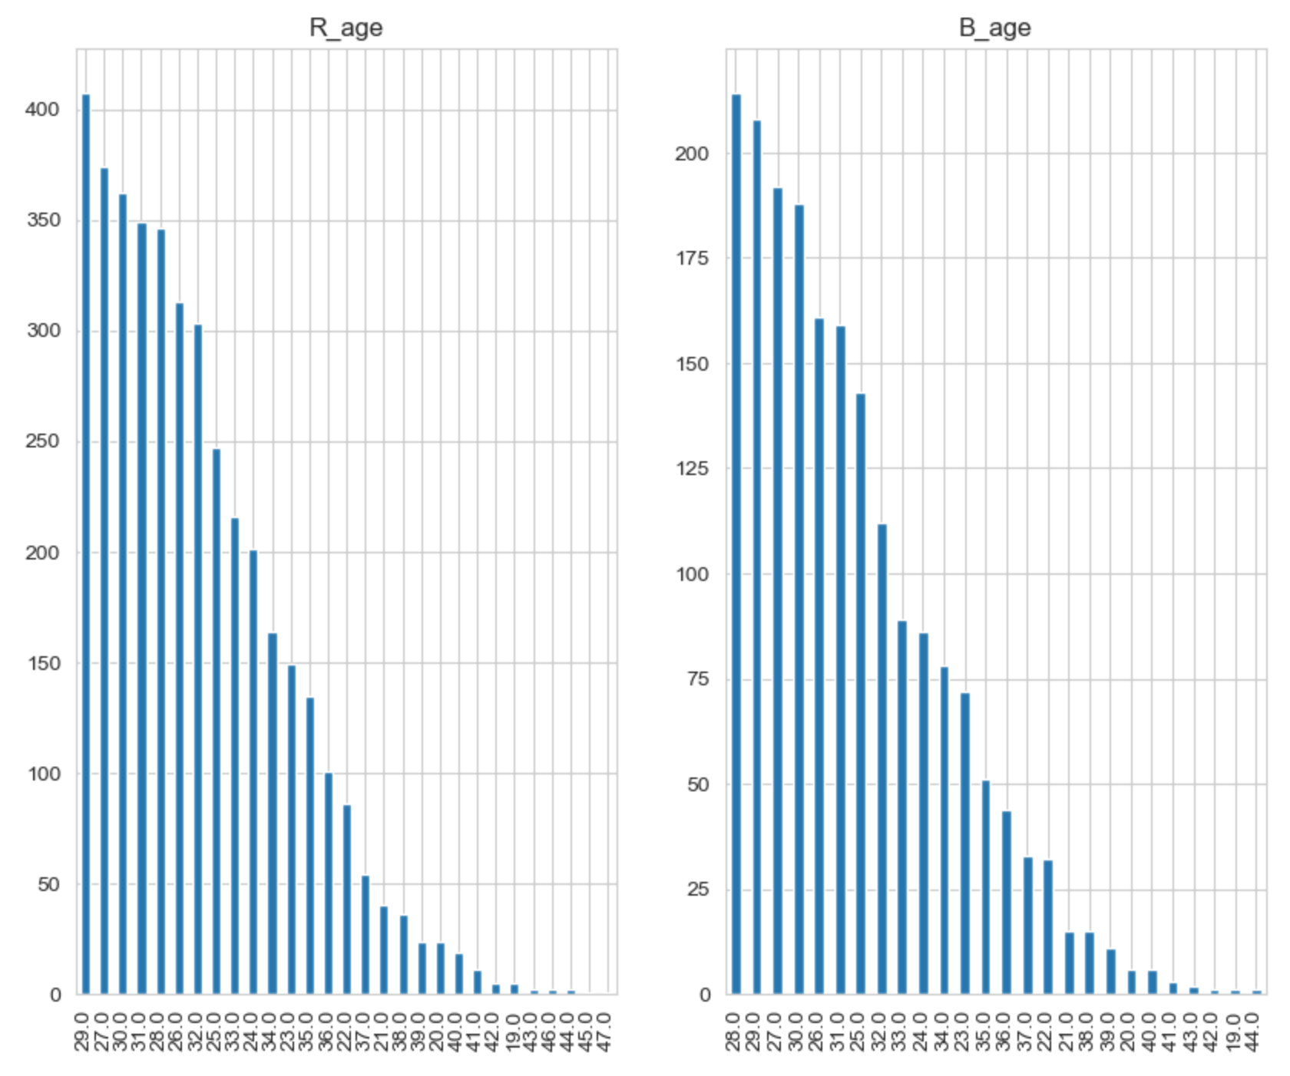
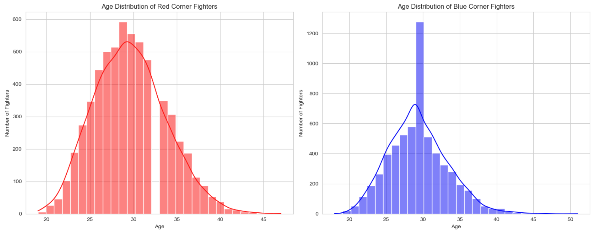
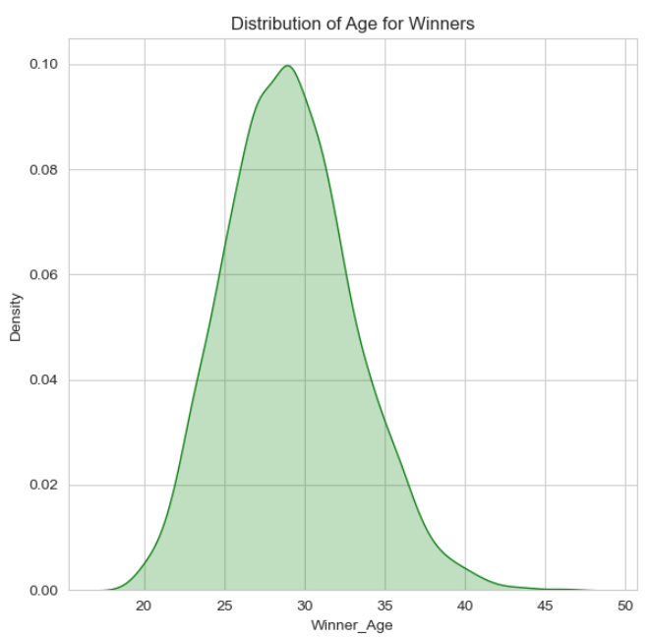
AGE IMPORTANCE

Slide 12
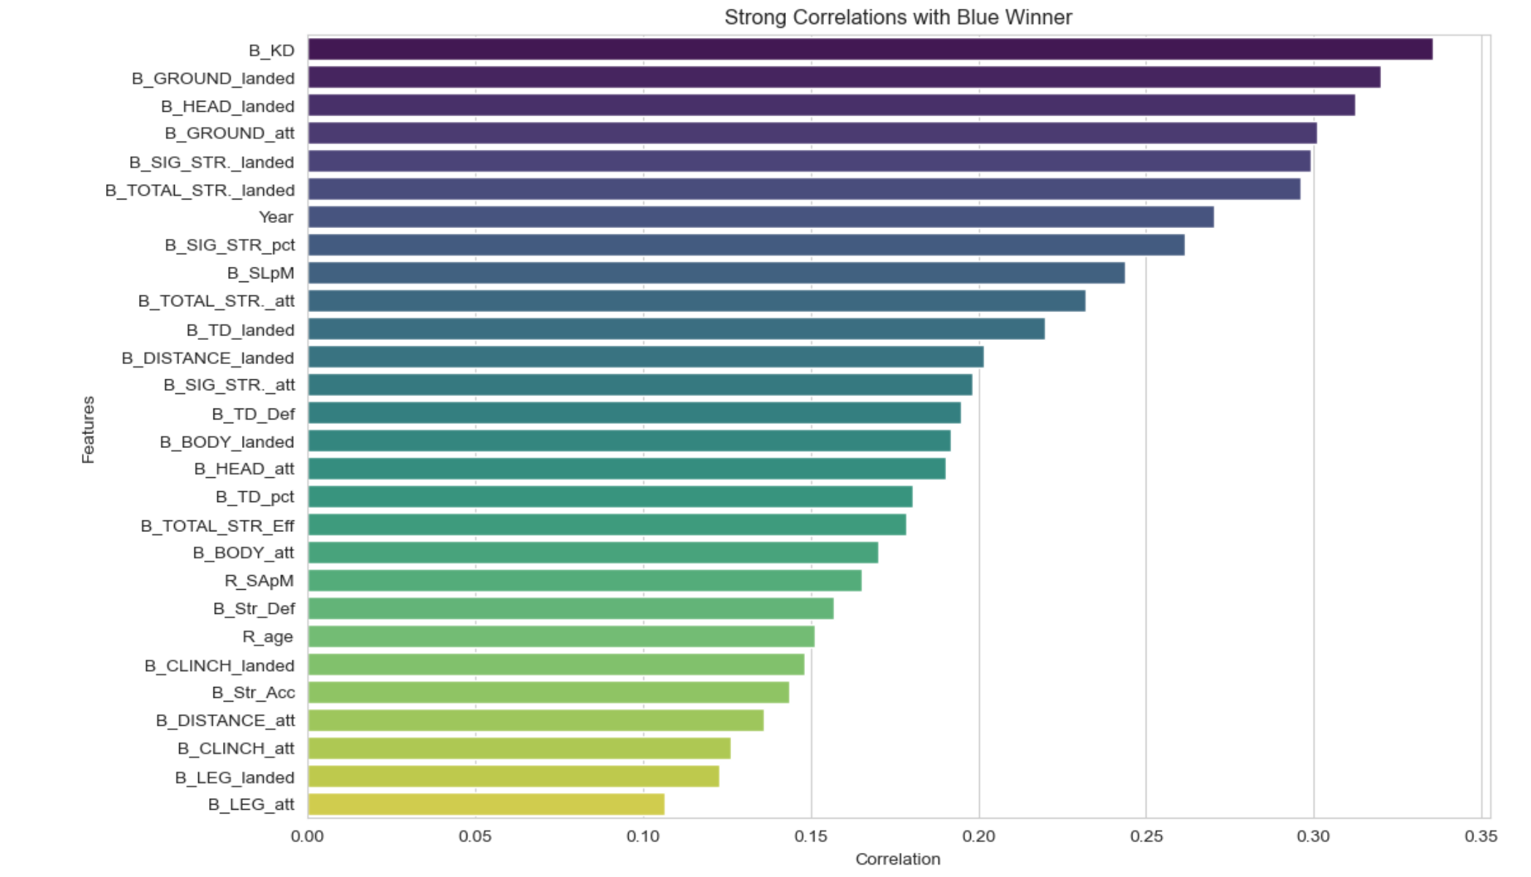
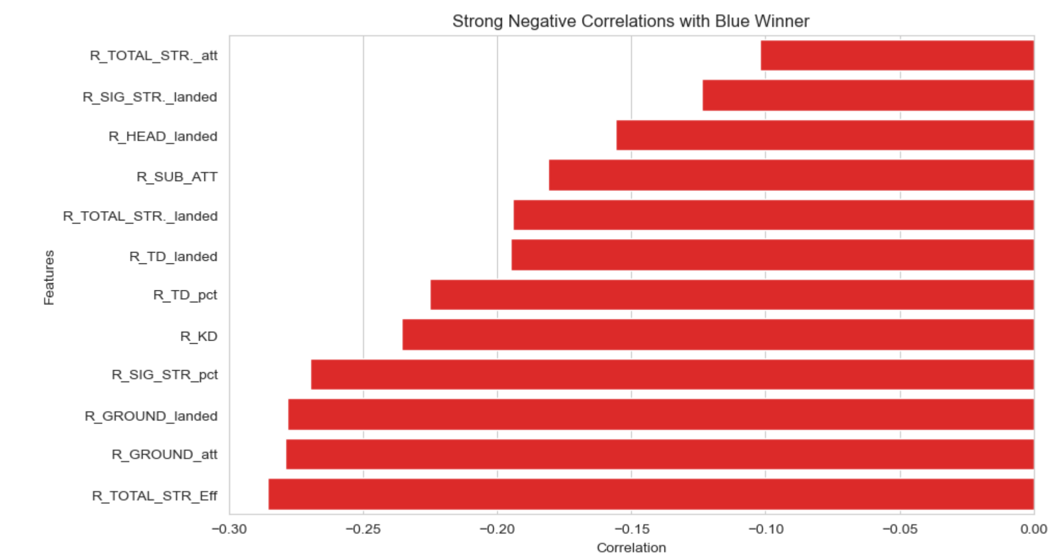
Feature importance (BLUE WINNER)

Slide 13
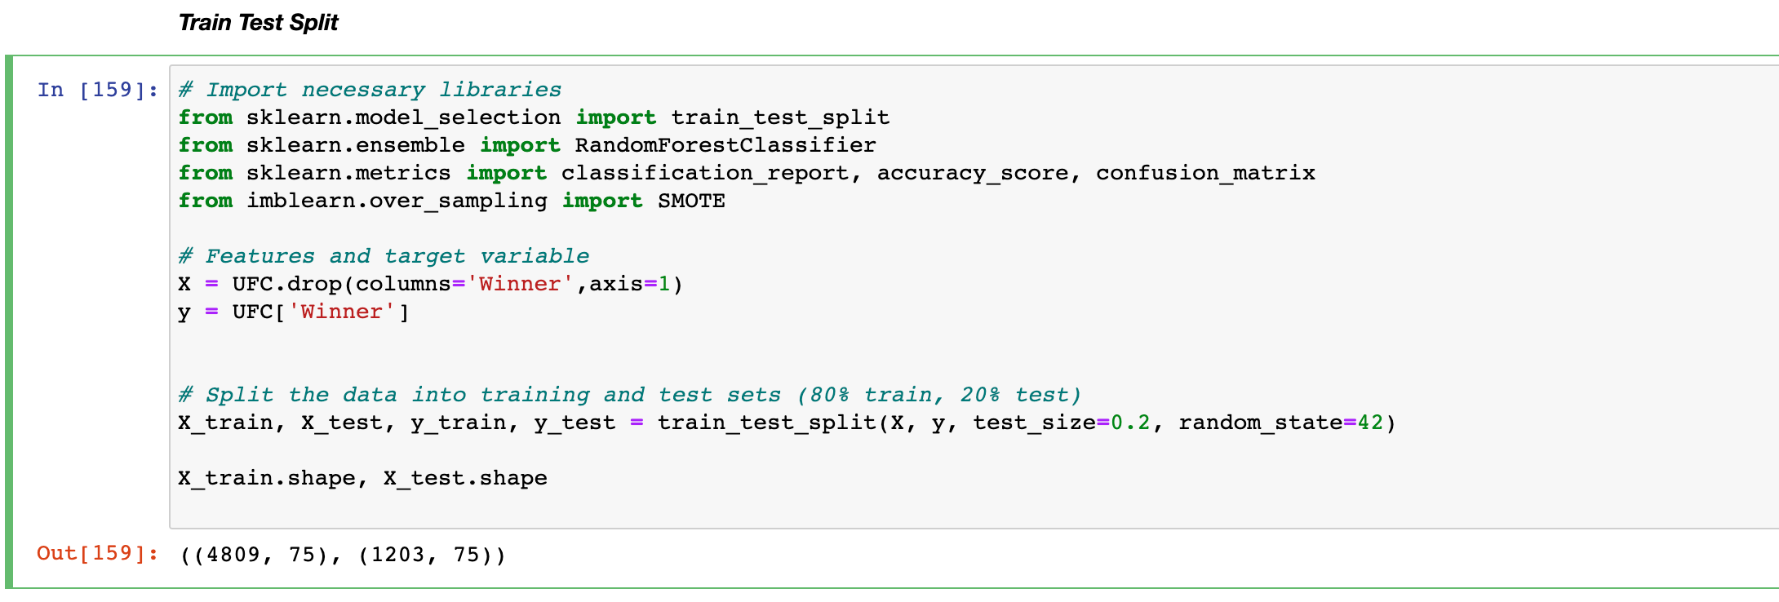
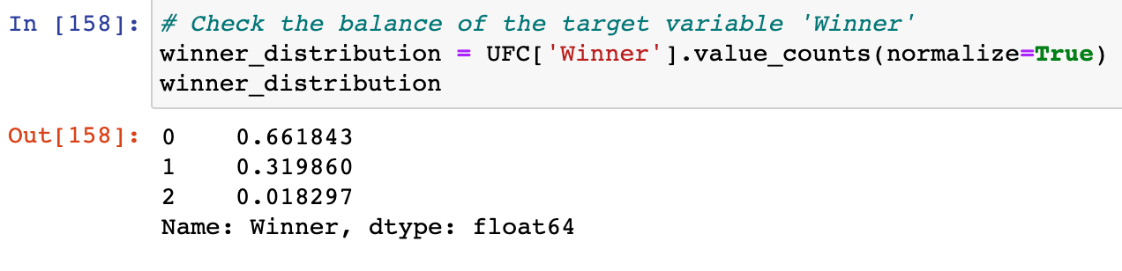
MODELS USED IN THIS PROJECT
RANDOM FOREST
XGBOOST
STACKING CLASSIFIER (Base models = random forest & xgboost, meta-model= Logistic regression)
FEEDFORWARD NEURAL NETWORK
SMOTE was used to address imbalance

Slide 14
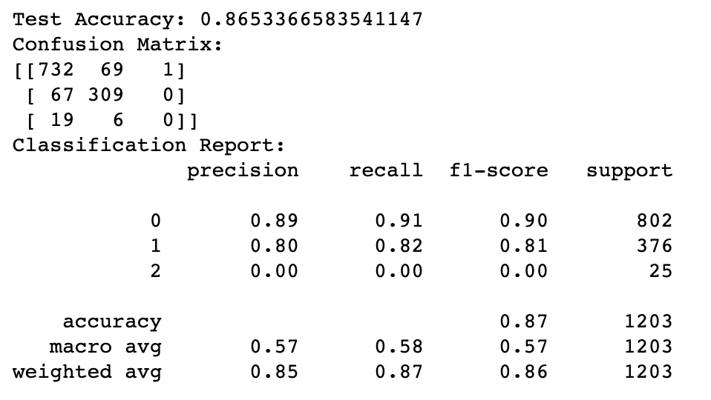
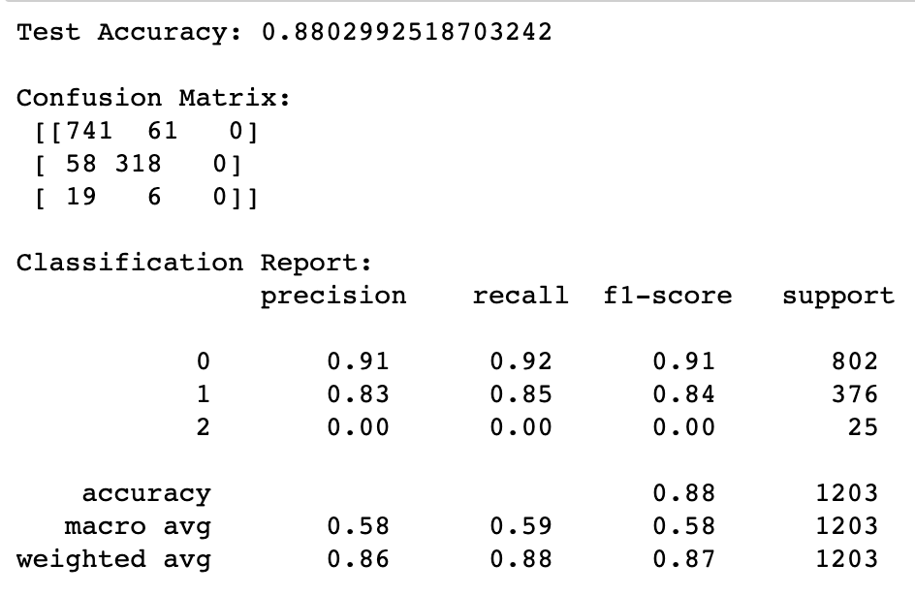
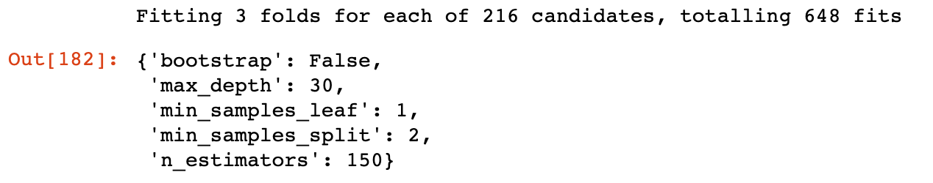
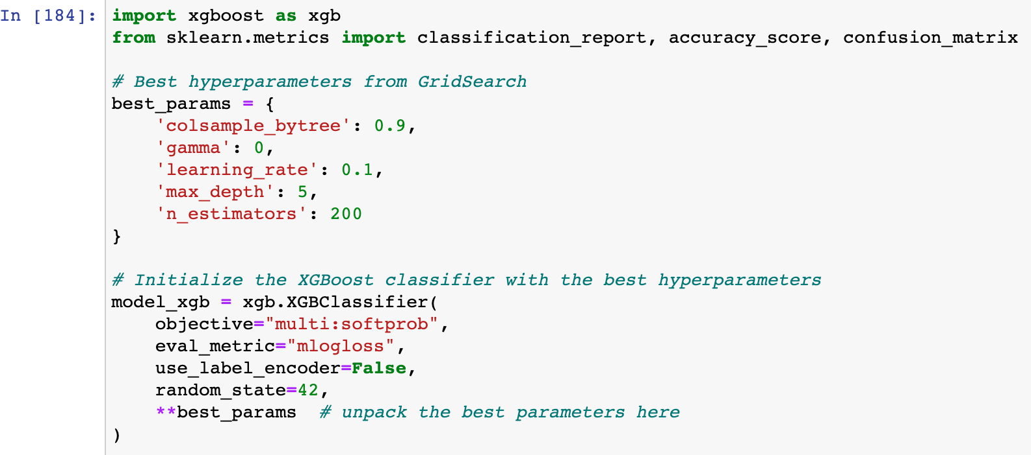
RANDOM FOREST and XGBOOST
Random Forrest results
XGBOOST results

Slide 15
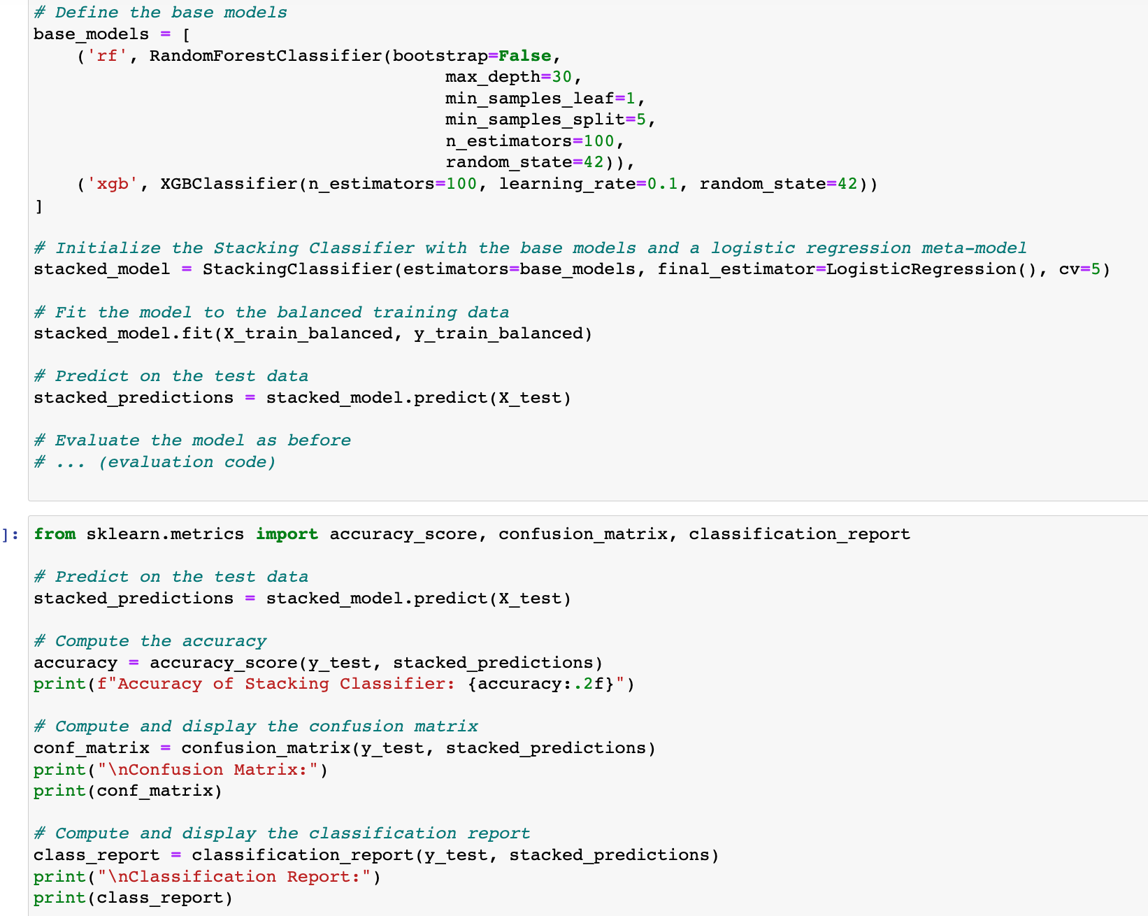
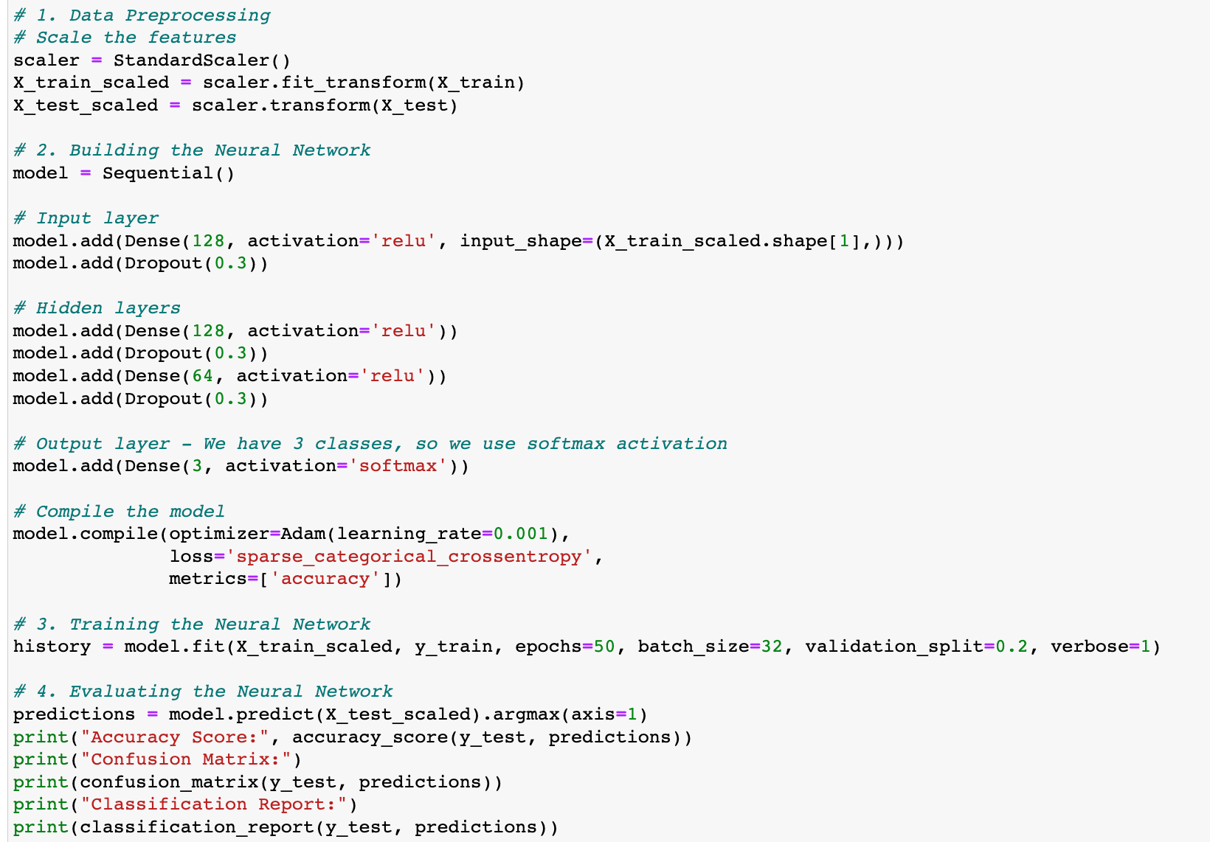
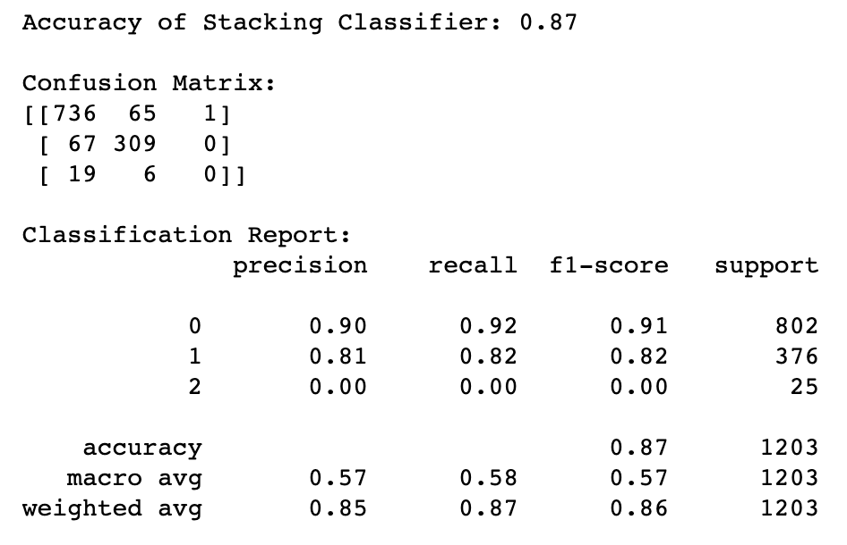
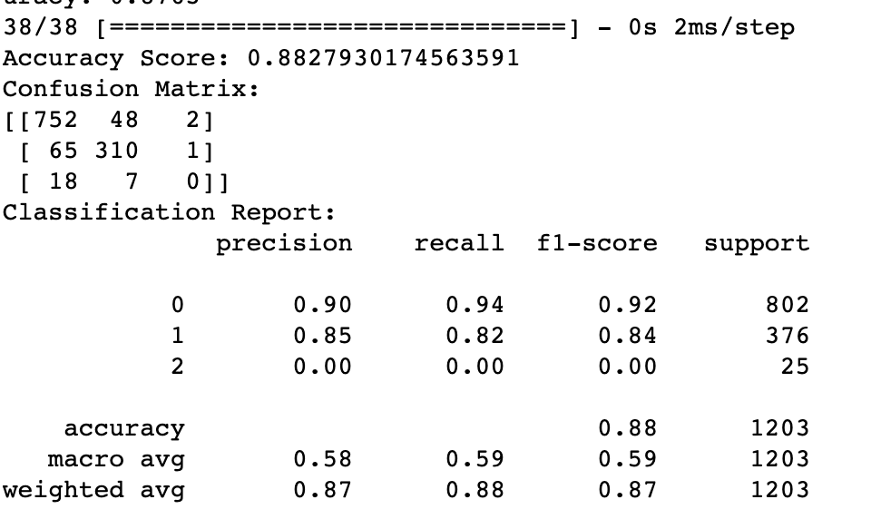
Stacking classifier and deep learning ml
Stacking classifier
Feedforward neural network

Slide 16
MODEL PROPOSITION
Based on the results, XGBoost after hyperparameter tuning and the Neural Network gave similar performance, with the Neural Network having a slightly better accuracy. However, there's more to model selection than just accuracy. Here are some criteria to consider:
Interpretability: Explanation to non-technical stakeholders, XGBoost might be preferable due to its inherent feature importance interpretation.
Operational considerations: Neural networks can sometimes be slower and more resource-intensive to deploy, especially with deeper architectures.
Generalization to new data: It's essential to ensure that the model isn't just fitting well to the test set but is also expected to perform well on entirely new data.
Considering the above, while the Neural Network may have given slightly better results, XGBoost (especially after hyperparameter tuning) is a robust, interpretable, and efficient model that might be more suitable for business applications in this context.

Slide 17
How to further improve the model?
gathering more data,
trying more advanced ensemble techniques
diving deeper into domain-specific feature engineering.
Testing out more models.

Slide 18
Business application
a. Strategic Betting:
The model can be used by individuals or entities involved in sports betting to make more informed decisions and increase their chances of placing successful bets.
b. Content Creation:
Media houses and sports analysts can use the model's predictions and insights to create engaging content for UFC fans.
c. Fan Engagement:
Predictions and insights can be leveraged in mobile apps or websites to engage fans by letting them see and possibly participate in predicting fight outcomes.
d. Event Planning:
Event organizers can use the model to anticipate outcomes and accordingly plan marketing and promotional activities.
e. Growth Opportunities:
UFC trainers and coaches can utilize model insights to focus on areas where fighters are weak, potentially increasing their chances in future fights.
f. Sponsorship and Advertising:
Brands can use the model to identify potential winning fighters to sponsor or to decide on advertising slots based on expected fight outcomes.

Slide 19
Thank you

